Slide 1
Orange Spain RPKI Incident Viewed From ICANN Managed (DNS) Root Server
Can BGP anycast save you?
Alain Durand
RIPE SEE 12
April 2024

Slide 2
Introduction
Early January 2024, Orange Spain suffered a serious routing RPKI-induced incident.
This talk will focus not on the incident itself, but will look at the availability of the ICANN Managed Root Server (IMRS) to Orange Spain during the incident.
As the routing outage was only affecting networks performing RPKI route origin validation and IMRS is using an anycast address replicated over hundreds of instances, one may ask if the root service was still available during the incident and, as an extension, if large scale anycasting is, or not, a mitigation to such RPKI-induced incidents.

Slide 3
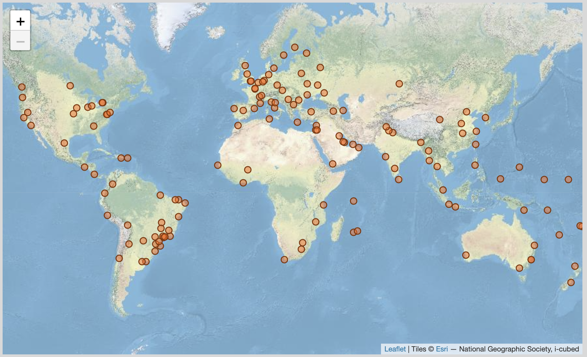
IMRS:
IMRS is the ICANN Managed Root Server
Formally known as L-root
Anycast service
191 instances
Located in 84 countries

Slide 4
Methodologie:
Get data from all 191 instances since Jan 1st to Jan 8th
Essentially tcpdump files, one per instance, 5 min span, compressed CBOR format
Align data (time) from all sources
Extract data from IP addresses hitting the root from Orange Spain
Calculate number of queries in each instance per 5 min slot
See if something changes during this week

Slide 5
What we were trying to see:
We may see a drop of queries during the outage… or not
We may see queries moving from one instance to another… or not
If we do see any of this, lets quantify it

Slide 10
31% of user queries on normal days

Slide 11
31% of user queries on normal days

Slide 12
31% of user queries on normal days

Slide 13
31% of user queries on normal days

Slide 14
12% of user queries on normal days

Slide 15
12% of user queries on normal days

Slide 16
25% of user queries on normal days

Slide 17
Conclusion
Service from IMRS was overall not discontinued.
BGP any cast is full of surprises.
DNS authoritative server placement best practices (not on the same subnet) also apply to recursive resolvers.

Slide 18
Engage with ICANN
Thank You and Questions
Visit us at icann.org
Email: email@icann.org
@icann
facebook.com/icannorg
youtube.com/icannnews
flickr.com/icann
linkedin/company/icann
soundcloud/icann
instagram.com/icannorg

